Slide 1
Lecture No. 29 Metallurgy
At the end of this lecture, students will be able to:
Explain the need of metallurgical processes
Discuss roasting and calcination reactions
Describe the reduction of ore and refining

Slide 2
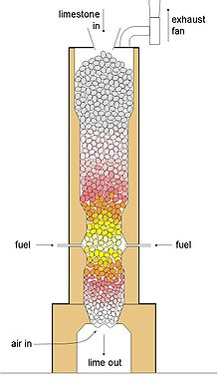
Calcination
Heating concentrated ore below its melting point in the absence of oxygen or limited supply of oxygen
Carbonate ores can be decomposed to form oxides
$FeCO_{3 }→Feo+CO_{2}$
(b) Water can be removed from hydrated ore
$$Fe_{2}O_{3 .}3H_{2}O→Fe_{2}O_{3}+3H_{2}O$$
(c) Volatile impurities if present can also be eliminated
Δ

Slide 3
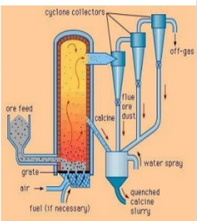
Roasting
Heating concentrated ore below its melting point in the presence of oxygen
At moderate temperatures,
$2ZnS \left(some portion\right)+3O_{2} →2ZnO+2SO_{2}↑$
$$ZnS \left(remaining portion\right)+2O_{2} →ZnSO_{4}$$
At high temperatures,
$$2ZnS+3O_{2} →2ZnO+2SO_{2}↑$$
When heated strongly some metals like Cu, Pb, Hg, Sb etc. are reduced to their metals
$$HgS+O_{2} →Hg+SO_{2}↑$$
Roasting removes volatile and easily oxidisable impurities such as As, S, P etc.

Slide 4
Calcination and Roasting
Calcination | Roasting
Ore is heated in the absence of air Mostly sulphide ores are used SO₂ is produced as a side product Metal can not be directly produced Volatile impurities can be eliminated | Ore is heated in the presence of air Mostly carbonates are used CO₂ is produced as a side product Directly metal can be produced in some cases, $$HgS+O_{2} →Hg+SO_{2}↑$$ Volatile and oxidisable impurities can be eliminated

Slide 5
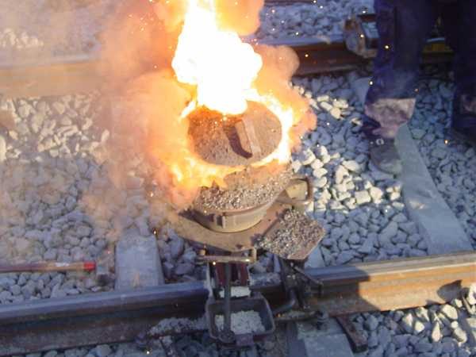
Reduction of ore
Reduction of metallic oxides:
Reduction of metallic oxides to free metals using aluminum is known as Gold-Schmidt’s aluminothermic process
Metal oxide is heated along with Al-powder
Exothermic reaction & liberated excess heat helps to melt the metals
$3MnO_{2}+4Al →3 Mn+2Al_{2}O_{3}$
$Cr_{2}O_{3}+2 Al →2Cr+Al_{2}O_{3}$
$3V_{2}O_{5}+10 Al →6V+5Al_{2}O_{3}$
Similarly using other metals such as Na, K, Mg, Ca etc. reduction of metal oxides to free metals can be achieved

Slide 6
Reduction of ore
Reduction of metal oxides using H₂ or water gas (CO + H₂)
Water gas or hydrogen can be used for the reduction
Metals which are less electropositive than H₂ can be reduced
Group 1, group 2 metals, Al and Zn can not be reduced because of their high electropositivity
$$CuO+ H_{2} →Cu+ H_{2}O$$
$$Ag_{2}O+ H_{2} →2Ag+ H_{2}O$$
$$2NiO+{CO+H}_{2} →Ni+CO_{2}+H_{2}O$$

Slide 7
Reduction of ore
Reduction by CO:
CO is used to reduce metal oxides to metals
Incomplete combustion results in the production of CO
CO can be oxidized to CO₂ gas, so separation becomes easy & metal oxide is reduced to metal
$PbO+CO→Pb+ {CO}_{2}$
$$FeO+CO→Fe+ {CO}_{2}$$
$$NiO+CO→Ni+ {CO}_{2}$$

Slide 8
Reduction of ore
Reduction of metal oxide using coke/coal:
Using carbon metal oxides can be reduced
Metals should not form carbides with carbon
Fe, Zn, Pb, Sn etc. can be reduced this way
$$ZnO+C →Zn+CO$$
$$NiO+C →Ni+CO$$
Limitations:
Metal carbides may be formed sometimes
Some reactions are reversible so they can form metal oxides and carbon again
To overcome these problems metals are converted into their alloys
Δ
Δ

Slide 9
Reduction of ore
Carbonate reduction:
$$ZnCO_{3} →ZnO+CO_{2}$$
$$ZnO+C →Zn+CO$$
Sulphide reduction:
$$HgS+O_{2} →Hg+SO_{2}$$
$PbS+Fe →Pb+FeS$
Sulphate reduction:
$$BaSO_{4}+4C →BaS+4CO$$
$$2BaS+3O_{2}→2BaO+2SO_{2}$$
$$3BaO+2Al →3Ba+Al_{2}O_{3}$$
Halide reduction:
$$VCl_{4}+2Mg →V+2MgCl_{2}$$
$$TiCl_{4}+2Mg →Ti+2MgCl_{2}$$
Δ
Δ
Δ
Δ
Δ
Δ
Δ
Δ
Δ

Slide 10
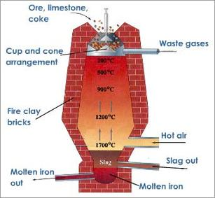
Reduction of ore-Smelting
After concentration some impurities are still present in the ore which needs to be eliminated
Acidic (SnO₂, P₂O₅) or basic (CaO, FeO, MgO) impurities are present
In this pyrometallurgical process ore is heated with a fuel and flex above the melting point
E.g., For haematite ore, coke is used as fuel and lime stone (CaCO₃ upon heating gives CaO) is used as flux
2C + O₂ → 2CO
Fe₂O₃+ 3CO → 2 Fe + 3 CO₂
$SiO_{2}+CaO →CaSiO_{3}(slag)$

Slide 11
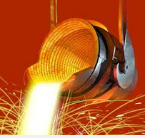
Reduction of ore-Smelting
Concentrated ore is mixed with coke or coal and a flux then heated strongly is known as smelting
Flux reacts with the impurities (acidic or basic) and forms a fusible mass which is known as slag (impurity layer)
Flux + Infusible impurity Slag
For acidic impurity basic flux should be used and for basic impurity acidic flux should be used
e.g., Tin stone (SnO₂) contains SiO₂ acidic impurity so during smelting ore is mixed with coal and CaO (basic flux)
$$SnO_{2}+2C →Sn+2CO↑$$
$$SiO_{2}+CaO →CaSiO_{3}(slag)$$
Δ

Slide 12
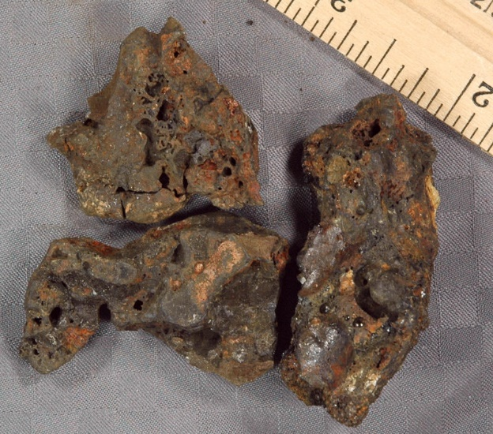
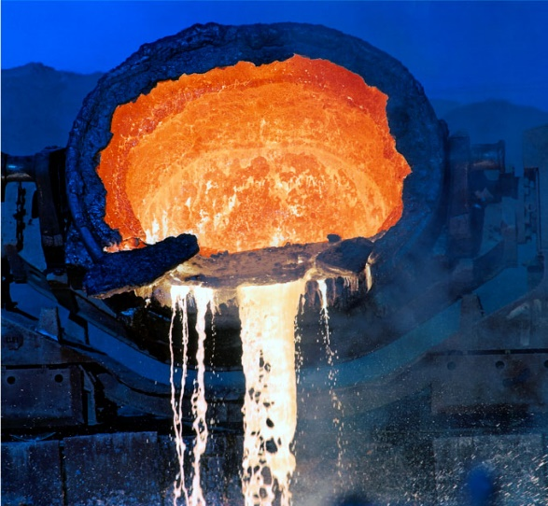
Reduction of ore-Smelting
Properties of slag:
It is a fusible or molten mass
Has lower melting point than ore so easily melts
Slag is lighter, immiscible molten layer
Slag floats over the metal layer so separation of slag is easier
Because slag floats on top it prevents oxidation of the metal

Slide 13
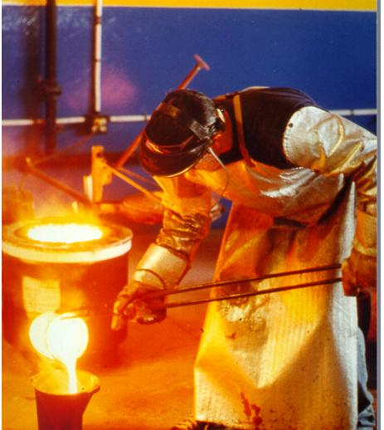
Refining/Purification
After concentration/smelting free metal is obtained
Metal still contains different types of impurities such as other metals, non-metals, unreduced oxides or sulphides, slag etc.
Refining is performed to get pure form of metal by eliminating the impurities to the maximum extent
There are many physical, chemical, electrolytic methods available
1. Liquation
2. Fractional distillation
3. Electro-refining

Slide 14
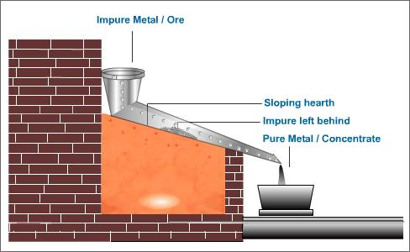
Refining-Liquation
It is a technique for separating constituents of an ore, a metal, or an alloy by partial melting
Used when the melting point of the metal is lower than the impurities & the impurities are not miscible with the metal
Metals like Bi, Sn, Pb, Hg etc. are purified by this technique
Sloping floor of the reverberatory furnace is used to melt the crude metal, when the temperature reaches the melting point of the metal it starts to flow down and impurities are left behind
Pure metal is collected separately

Slide 15
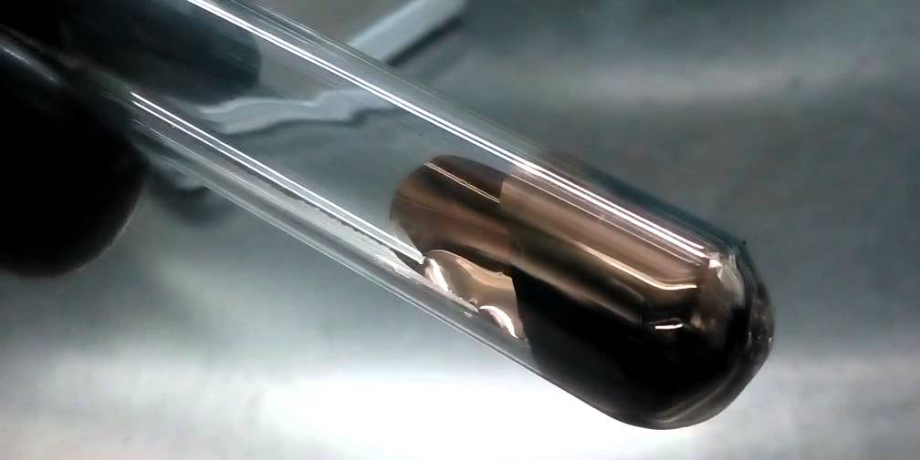
Refining-Fractional distillation
Using boiling point differences metals can be distilled and purified
Volatile metal and non-volatile impurities can be refined or vice-versa
e.g., Hg, Cd, Zn etc., any soft metals with low melting and boiling points can be distilled
When temperature reaches the boiling point of the metal it vaporizes and the impurities are left behind in solid state
Metal vapors will be condensed separately and the pure metal (99.99%) can be obtained

Slide 16
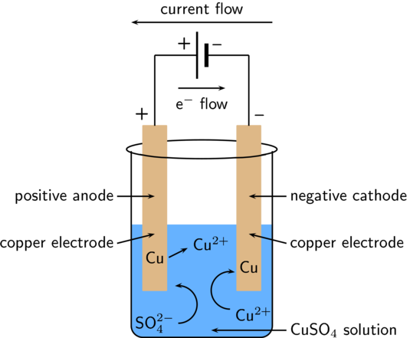
Electro-refining
This method is an electrolysis of a metal containing ore or compound to obtain metal of very high purity
Metals such as Cu, Ag, Au, Zn, Sn, Pb, Ni etc. are purified by the electro-refining process
In this method, anode (+ve electrode) is made of impure metal while the cathode (-ve electrode) is made of pure metal (a rod or sheet) of the electrolytic cell
Electrolytic solution consists
of a soluble salt of the metal
(Pure Cu)

Slide 17
Electro-refining
On passing electricity, the pure metal gets deposited on the cathode after reduction
While the insoluble impurities settle down below the anode as anode mud /anode sludge or soluble impurities present in the solution
At anode (oxidation),
$$M →M^{n+}+ne^{−}$$
At cathode (reduction),
$$M^{n+}+ {ne}^{−} →M\text{(}\text{pure}\text{)}$$
Thus electrolysis yields high purity metal at cathode

Slide 18
Summary
Heating concentrated ore below its melting point in the absence of oxygen is calcination
Heating concentrated ore below its melting point in the presence of oxygen is roasting
Metal oxides can be reduced to free metals by smelting, aluminothermic process, reduction using H₂, water gas, CO, coke etc.
Using same methods other ores such as sulphides, sulpahtes, halides etc. can be reduced to free metals
After concentration metals are refined to get higher purity
Different physical, chemical and electrochemical methods such as liquation, fractional distillation, electrorefining etc. are used to refine the metals

